Slide 1

Final Year Project

Slide 2

Last Week Feedback
. Very Important To Upload Homepage to Github
. Think about what you will aim to finish by Milestone 3
. Need to finish Use Cases and Explain it
. Start some work on personalised tips page
. Think about what you will use for backend
. Think about frontend
. Make sure to spend at least a hour or so per day on work
. Do some work on Sign Up/Login Page

Slide 3
The week achievements
My Covid Diary – Preventing The Spread
. Uploaded Homepage
. Finish Login/Sign Up Page
. Did some work on personalised tips page
. Finished Use cases
. Thought about what to use for Frontend and backend (React.js Frontend – Backend Ruby/Python)
. Did some work on Frontend with ReactJS
. Goals for Milestone 3 on target
. Github is Updated
. Contact Us Form

Slide 4
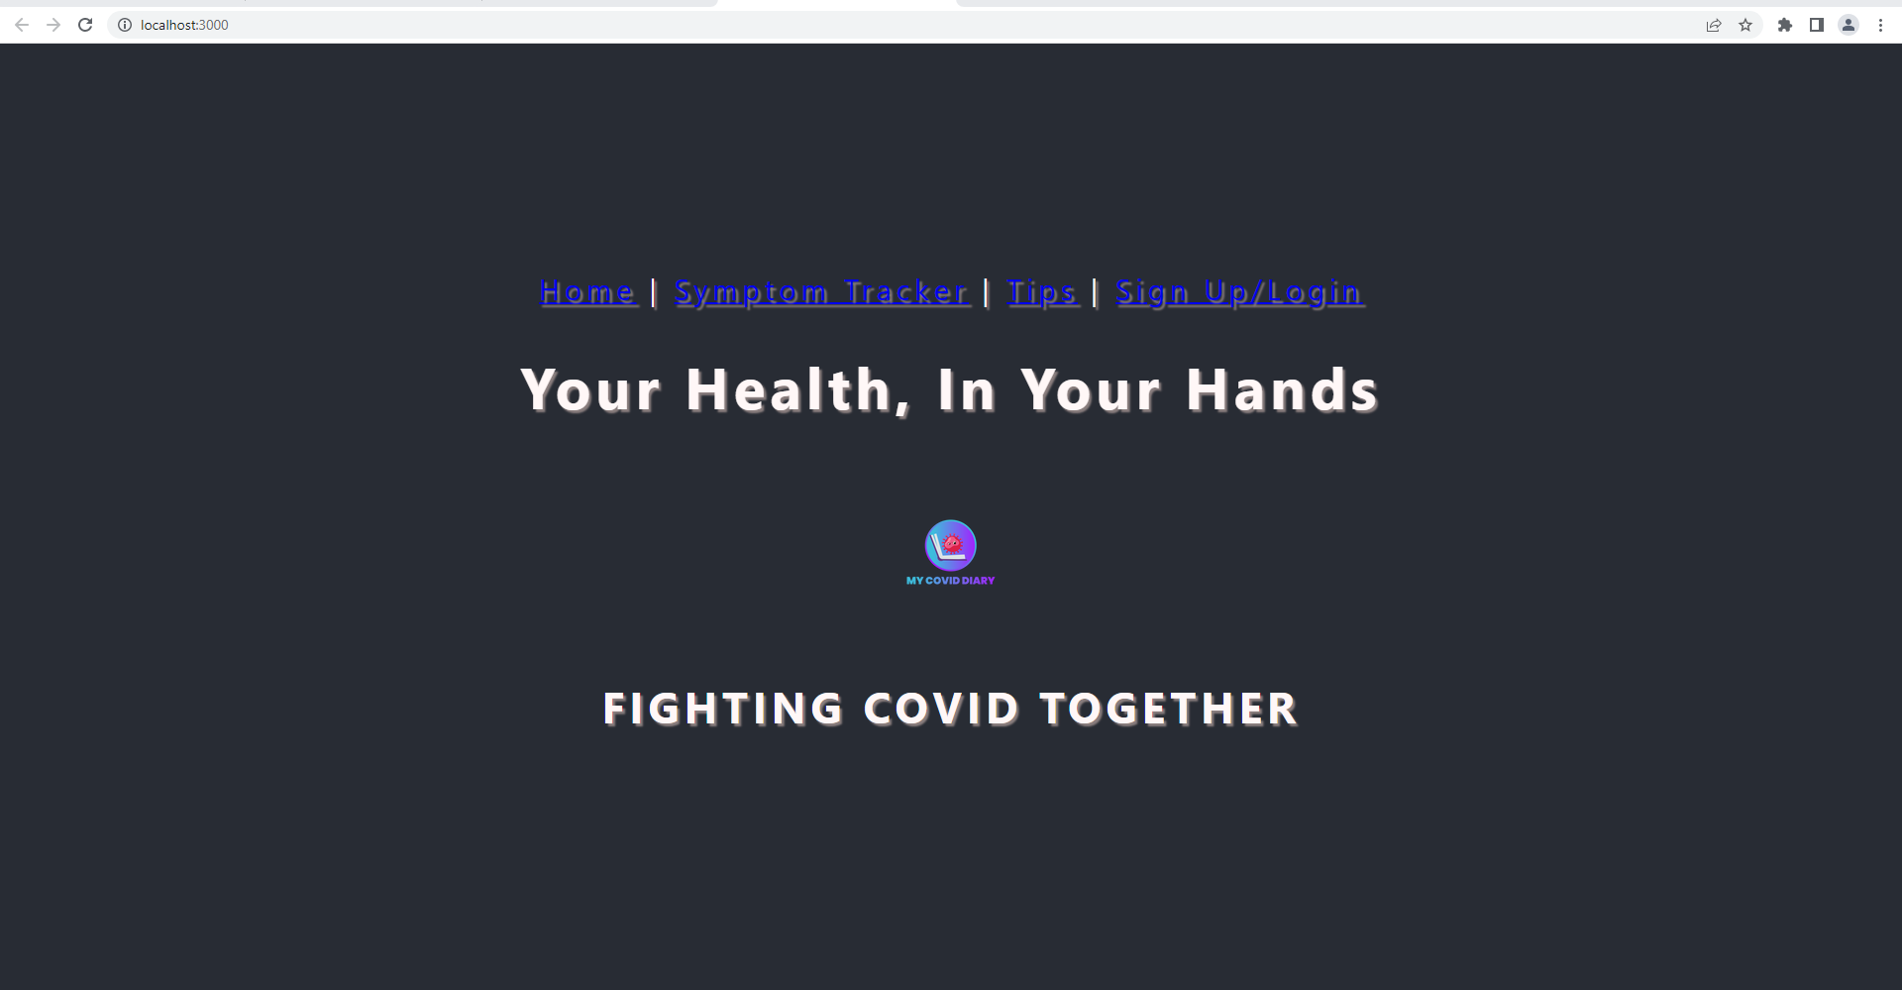
Homepage Work
More work needs to be done on overall layout/more images and text to fill the blank

Slide 5
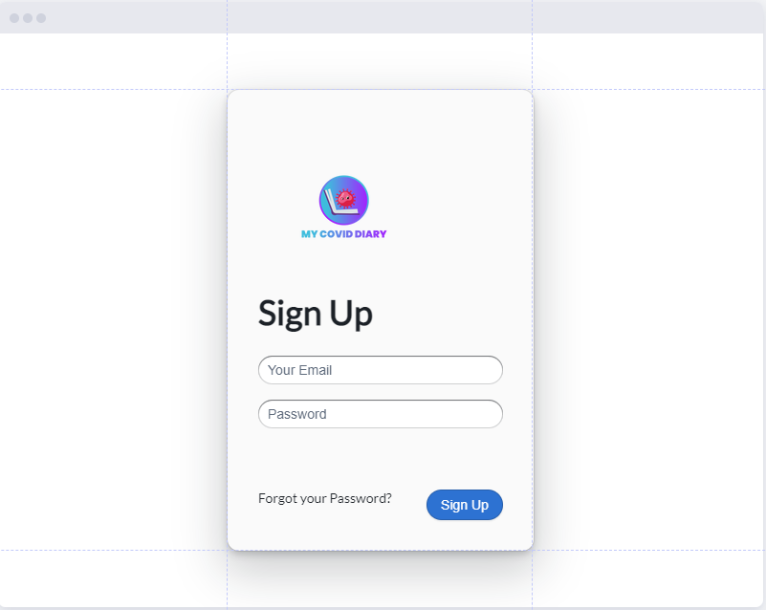
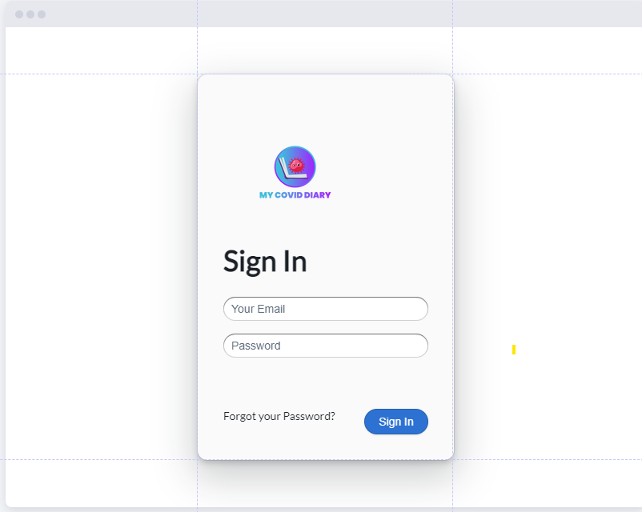
Sign Up/Sign In Template Done

Slide 6
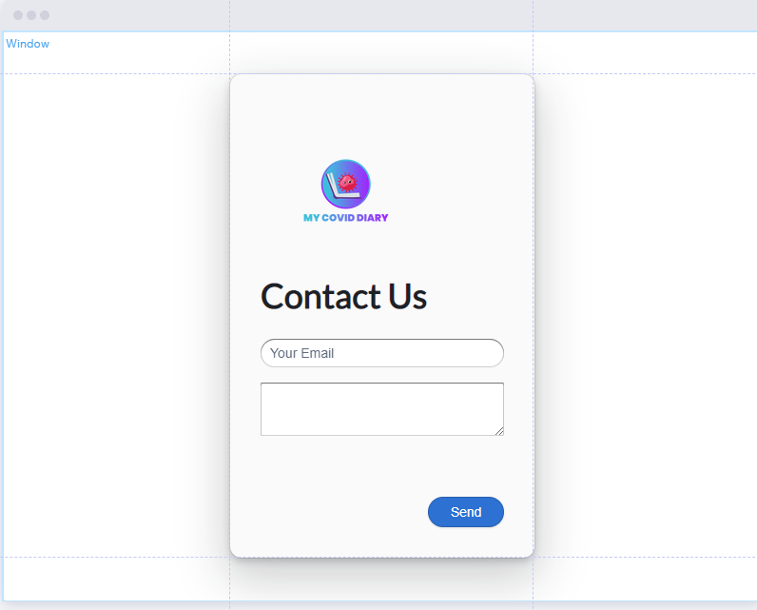
Contact Us Page

Slide 7
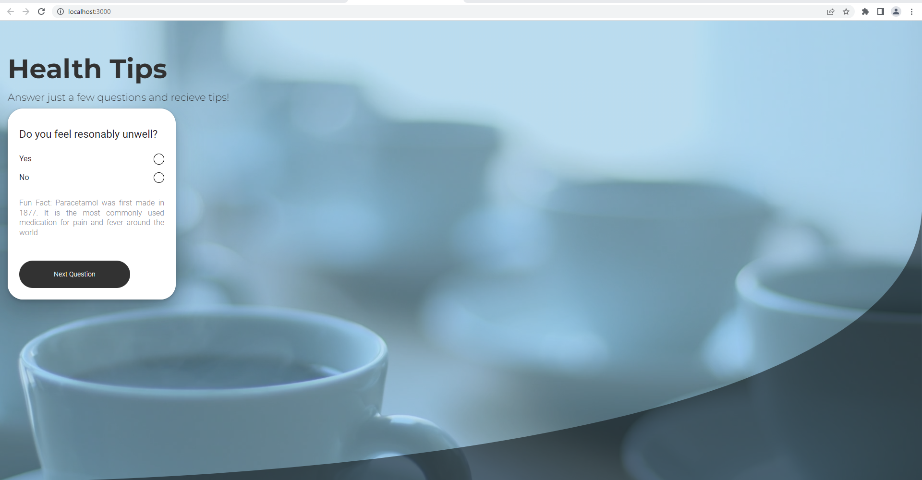
Personalised Tips Page

Slide 8
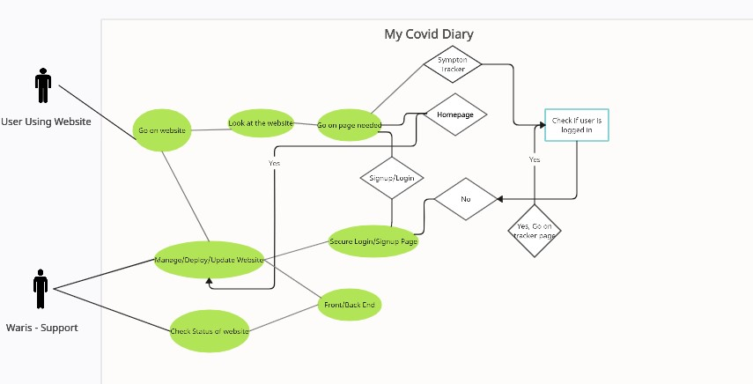
Use Cases

Slide 9
Issues
. Had some trouble with using ReactJS – More confident now after watching tutorials
. Github Repo had some issues with travis ci but now fixed

Slide 10
Next Week Goals
Do Some more work On Homepage
Integrate the database to login/signup page
Integrate all the pages together
Add some more questions on personalised tips
Think about logic you will use for personalised tips
Do a persona Profile for a average user of the website
Start working on backend
Flow chat – How questions will work
Written Use Case
Summary Of Top Requirements
Have demo ready – Personalised Tips Page

Slide 11
Thank You For Watching

